Slide 1

PROJECT PRESENTATION ON TEST AUTOMATION
TEAM NAME – BUG CRAWLERS

Slide 2
Team Members
Rajgauri Vedpathak - 109446
Vivek Kamath - 109452
Harini S - 109445
Pooja Badiger - 300470
A Syed Abrar - 109454
Instructor & Guide - Saravanan R

Slide 3

SECURITY TESTING
Security Testing is a type of Software Testing that uncovers vulnerabilities of the system and determines that the data and resources of the system are protected from possible intruders.
It ensures that the software system and application are free from any threats or risks that can cause a loss.

Slide 4
Top 10 Vulnerabilities (According To OWASP)
Injection Flaws
Cross Site Scripting
Broken Authentication & Session Management
Insecure Direct Object Reference
Cross Site Request Forgery
Security Misconfigurations
Insecure Cryptographic Storage
Failure to Restrict URL Access
Insufficient Transport Layer Protection
Unvalidated Redirects & Forwards

Slide 5

Tool Used
Acunetix is an automated web application security testing tool that audits your web applications by checking for vulnerabilities like SQL Injection, Cross site scripting and other exploitable vulnerabilities.

Slide 6
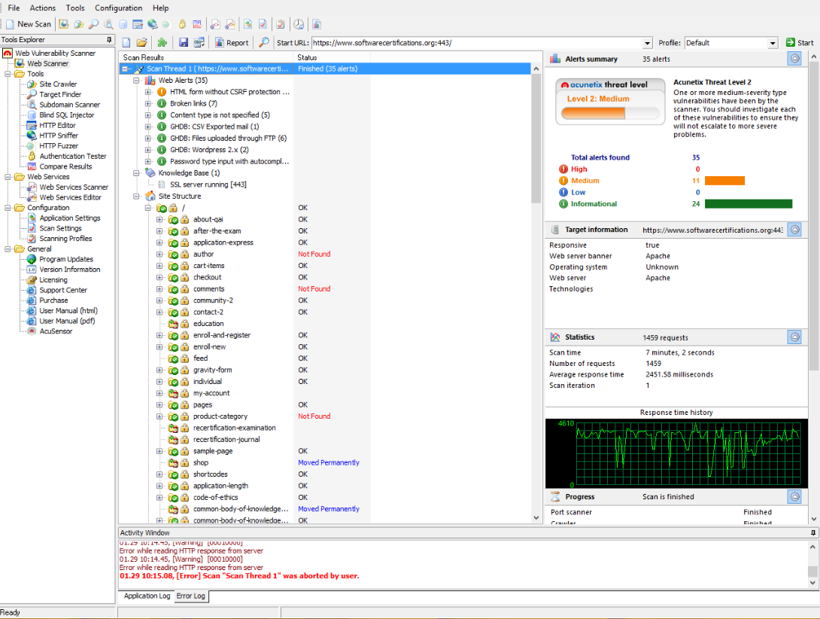
Security Scanning

Slide 7
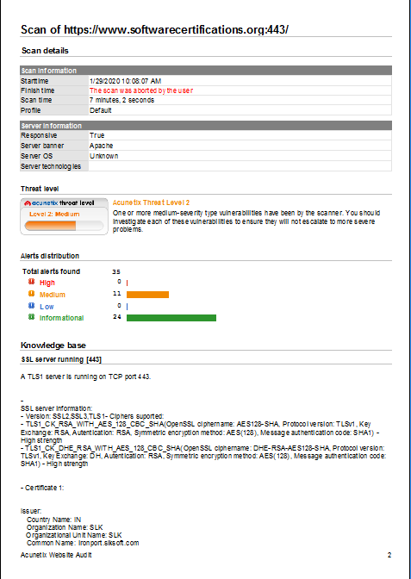
Report

Slide 8

Soap UI
Environment Description-
Soap is simple XML-based protocol. It allows the exchange of information over HTTP.
SoapUI is an open source cross-platform web service testing tool.

Slide 9
AUT Description
Apache Axis2 is a web service application that allows user to add, view or delete employee details.
Environment Description
OS – Windows 10
Tool – Soap UI
Programming Language- Groovy Script & Xml

Slide 10
AUT Features
Sign Up Page
Add Employee Details :
User should be able to add employee details such as name, id, age & department to the database.
Get Employee Details :
User should be able to view the employee details saved in the database.
Delete Employee Details :
User should be able to delete employee details from the database.

Slide 11

Testing using SoapUI
Manual testing is the process of manually testing software for defects. It requires Manual testing is the process of manually testing software for defects.
It requires a tester to play the role of an end user whereby they use most of the application's features to ensure correct behavior.to ensure correct behavior.

Slide 12
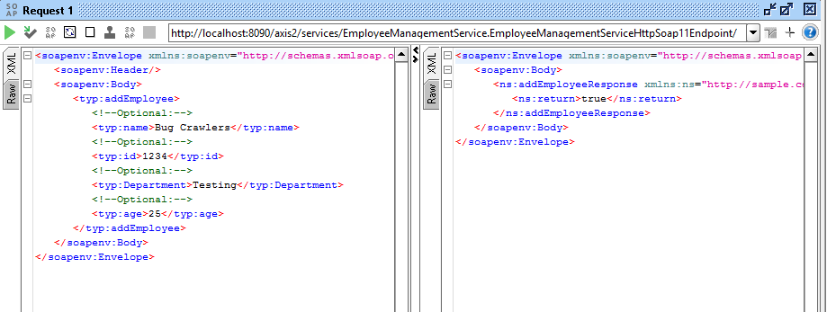
Add Employee Response

Slide 13
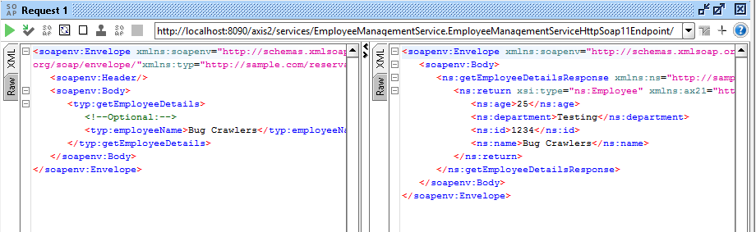
Get Employee Response

Slide 14
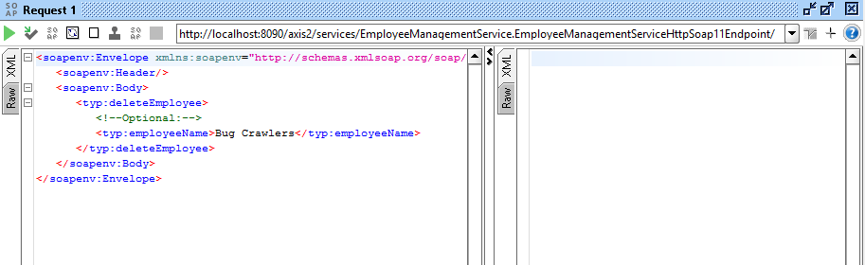
Delete Employee Response

Slide 15
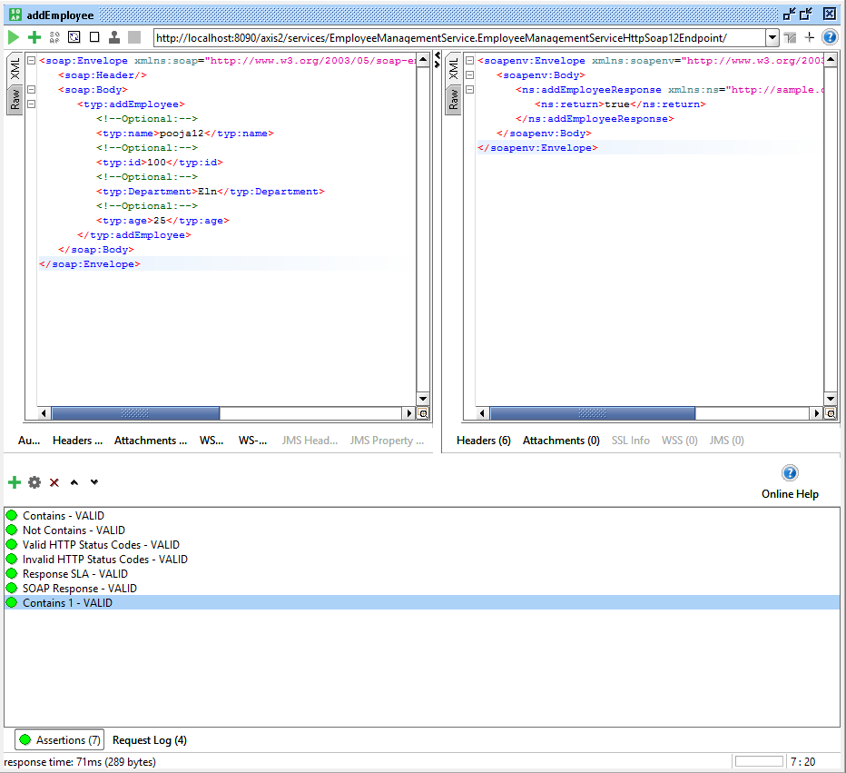
Assertions
Assertions Used

Slide 16
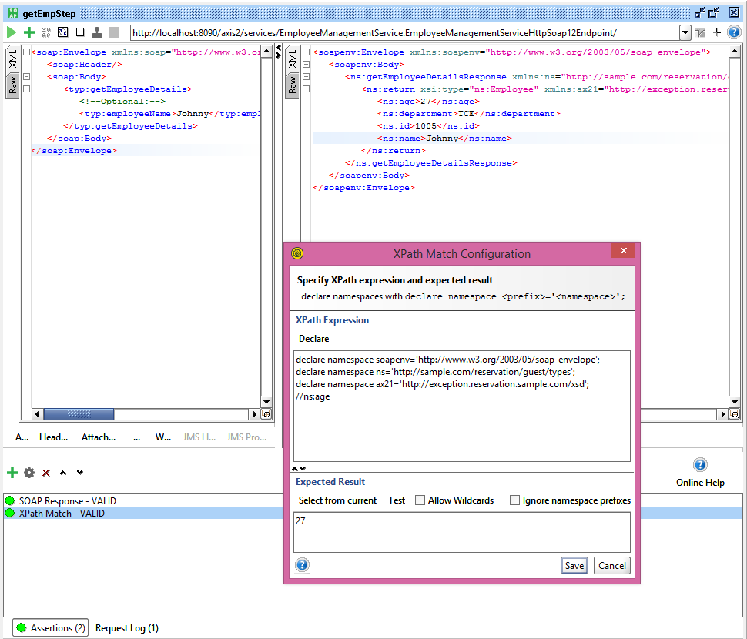
Assertions Using XPATH
Edit Grocery Page

Slide 17

Testing Using Groovy Scripts
Software Test automation makes use of specialized tools to control the execution of tests and compares the actual results against the expected result.
Usually, regression tests, which are repetitive actions, are automated.

Slide 18
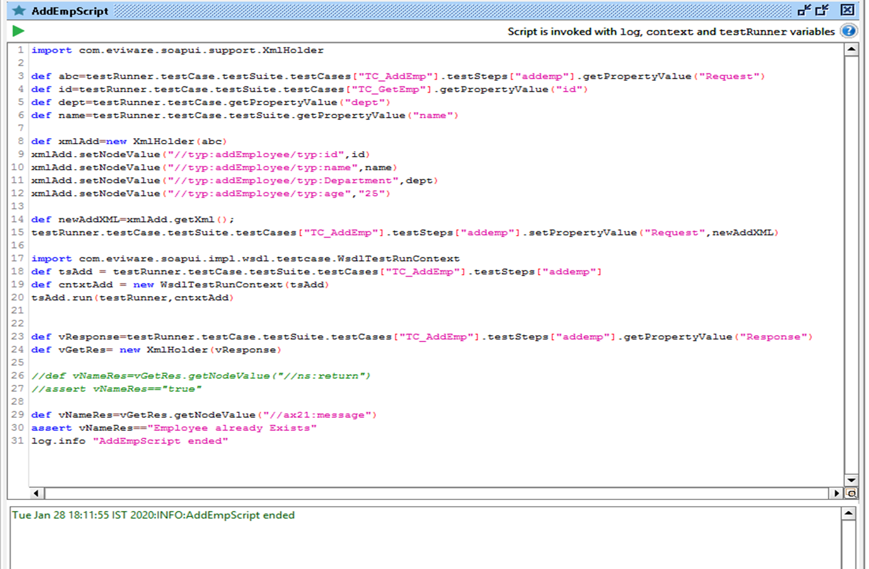
Groovy Script For Add Employee

Slide 19
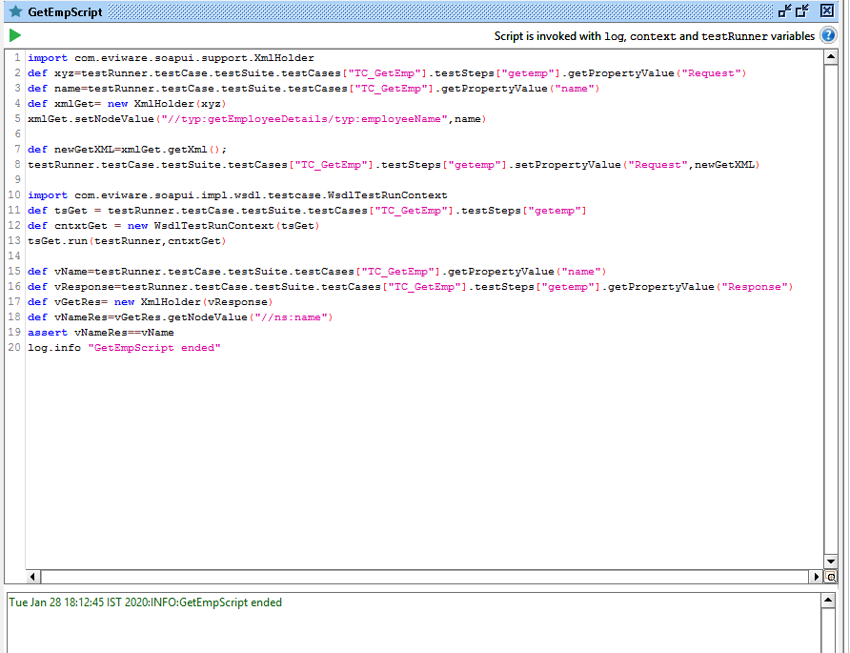
Groovy Script For Get Employee

Slide 20
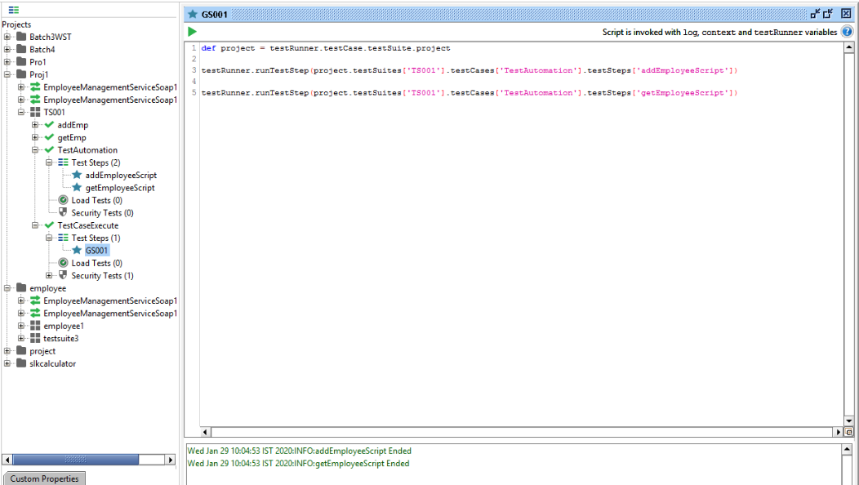
Regression Testing

Slide 21
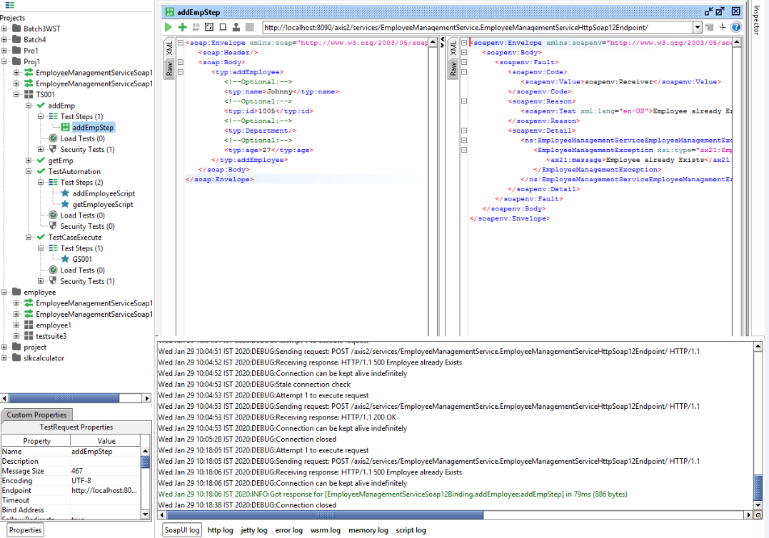
Test Execution

Slide 22
SELENIUM PROJECTS

Slide 23
Project 1 : You Can Deal with It

Slide 24
Description
In this project, we tested the website- http://www.youcandealwithit.com/ by using Selenium tool.
The steps are as follows:
Go to “http://www.youcandealwithit.com”.
Navigate to Borrowers.
Click on Calculators & Resources.
Click on Calculator.
Click on Budget Calculator.
Enter details on- food, clothing & shelters through variables.
Enter details on Monthly Pay & Others through variables.
Capture Monthly Expense & print as “Monthly Expense is:”.
Capture Monthly Income & print as “Monthly Income is:”.
Print “You Are Warren Buffet” if Monthly Expense is lesser than Monthly Income.
Print “You Are Poor In Savings” if Monthly Expense is more than Monthly Income.

Slide 25
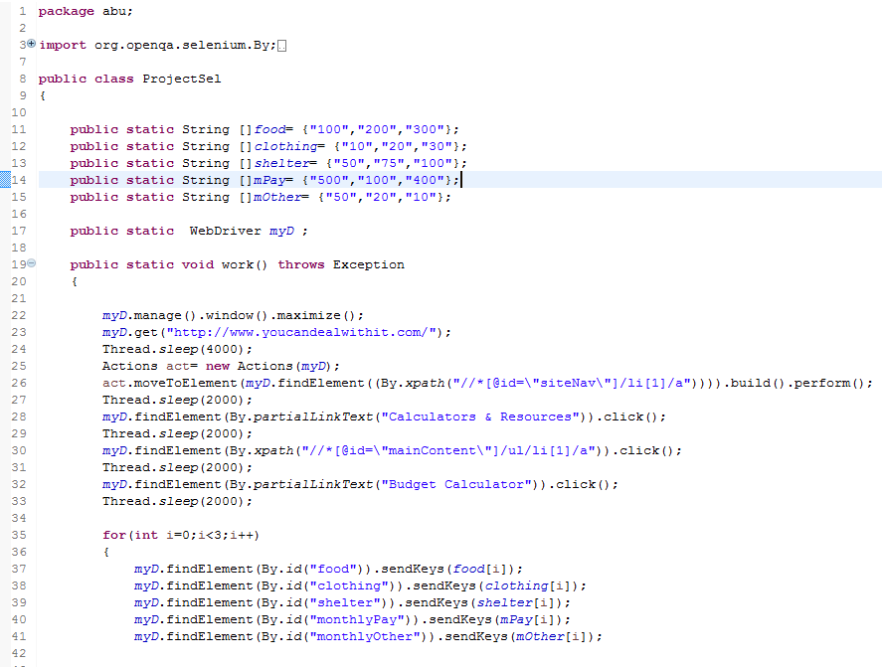
Code

Slide 26
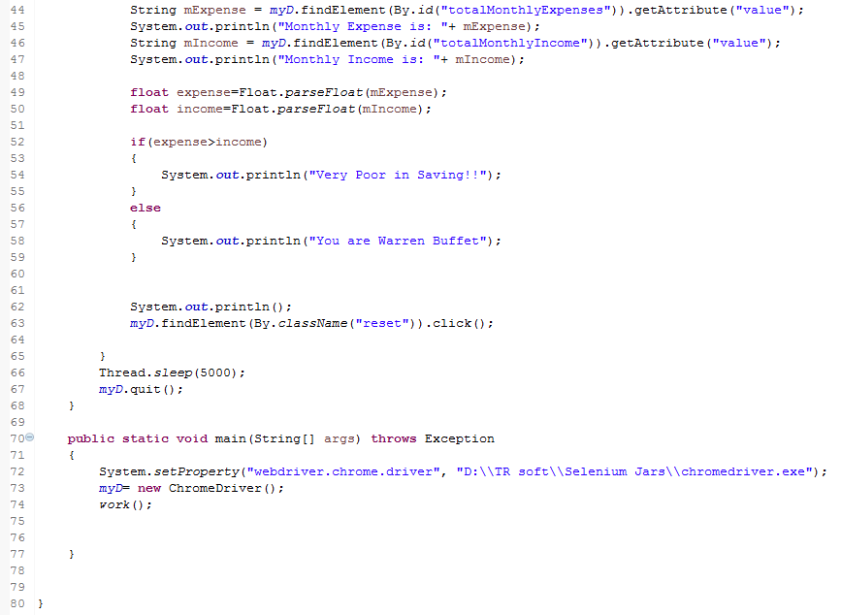
Contd.

Slide 27
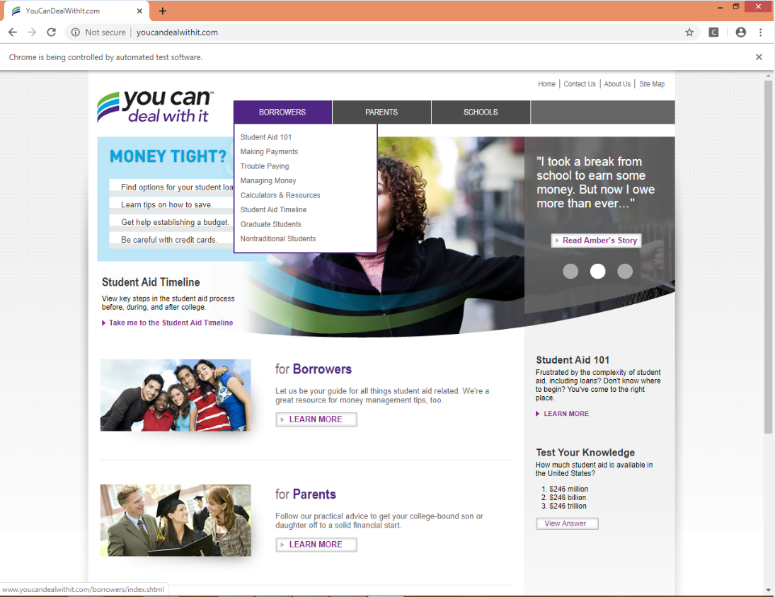
Execution

Slide 28
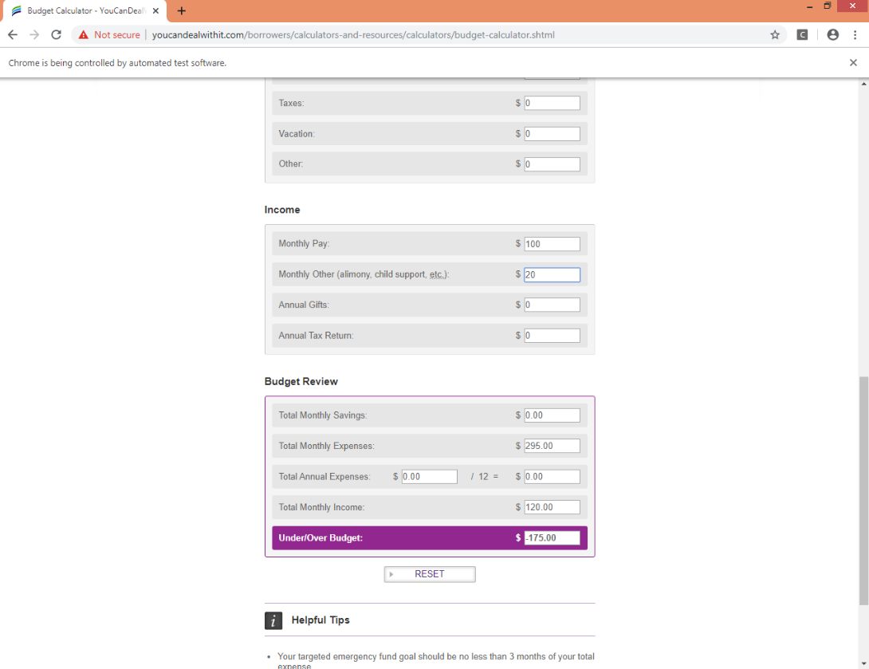
Contd.

Slide 29
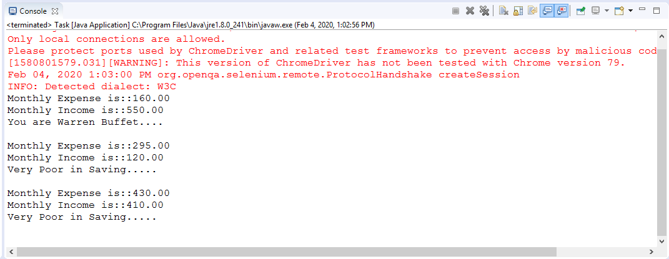
Console Output

Slide 30
Project 2 : Rediff Mail

Slide 31
Description
In this project, we tested the website- “https://register.rediff.com/register/register.php?FormName=user_details” by using Selenium tool.
The steps are as follows:
Go to “https://register.rediff.com/register/register.php?FormName=user_details”.
Write Full Name.
Choose a Rediffmail ID.
Enter Password.
Retype password.
Click on checkbox if alternate email ID is not available.
Change Country code of Mobile No.
Select Gender.
Select Country.

Slide 32
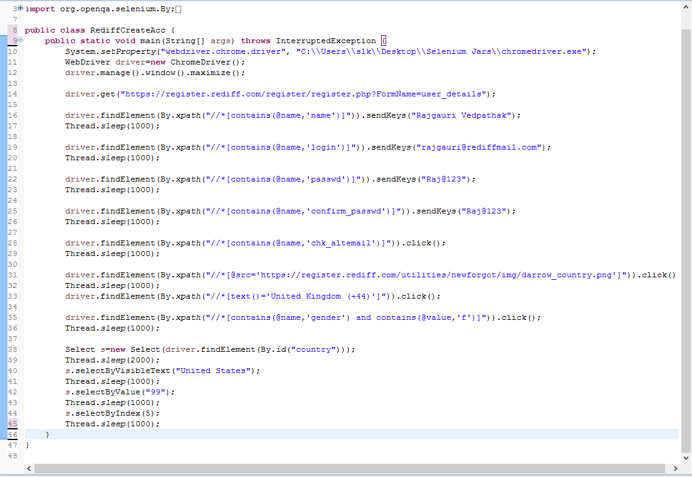
Code

Slide 33
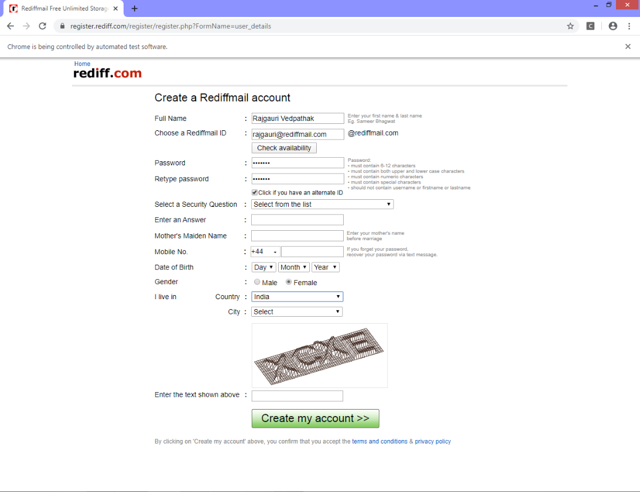
Execution

Slide 34
Project 3 : Data Driven Testing

Slide 35
Description
In this project, we tested the website- “https://www.google.com/” by using Selenium tool & Automated Script to Read & Write data in Excel Sheet.
The steps are as follows:
Go to “https://www.google.com/”.
Write a script to type something, Click on Google Search, get Title of page.
Write code to read & write data in Excel Sheet.
Add Jar File (poi-3.9 jar).
Take Screenshot of Failed Test Cases & save it in folder.

Slide 36
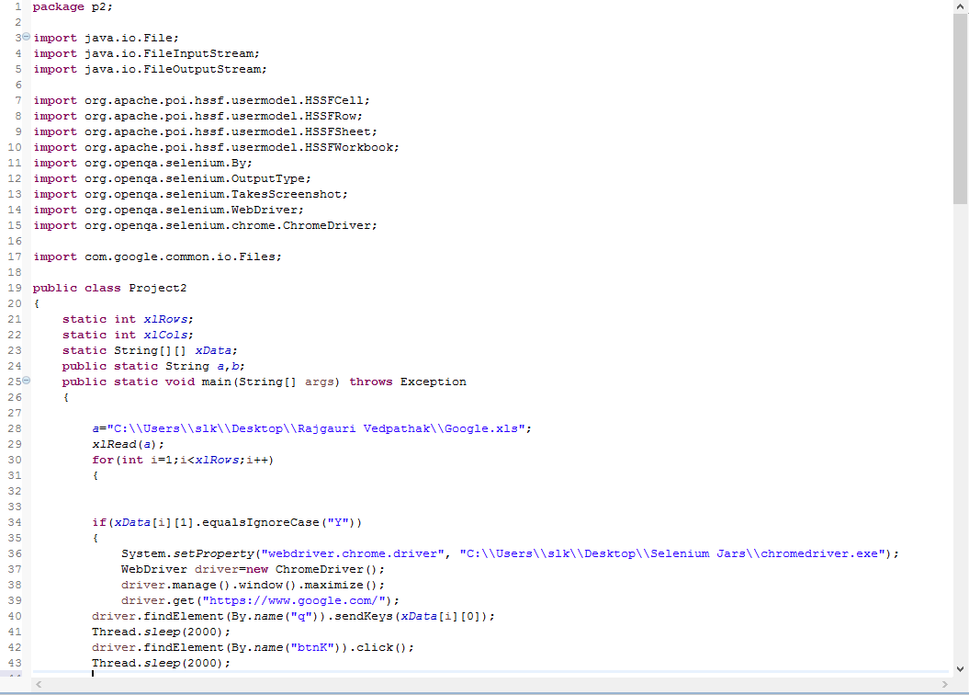
Code

Slide 37
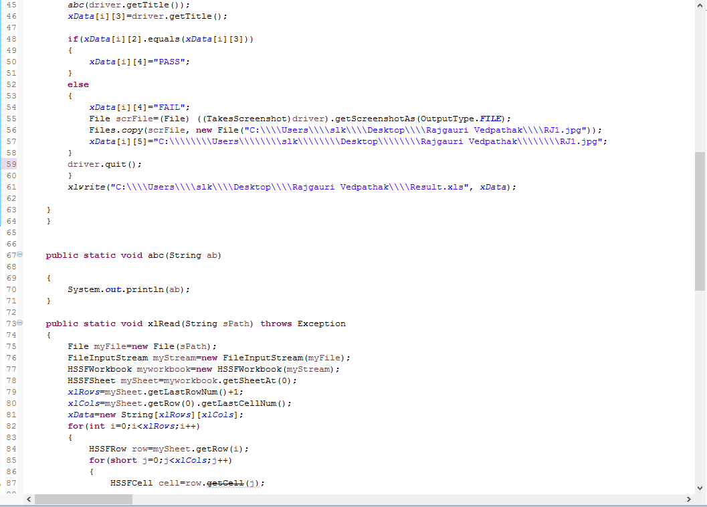
Contd.

Slide 38
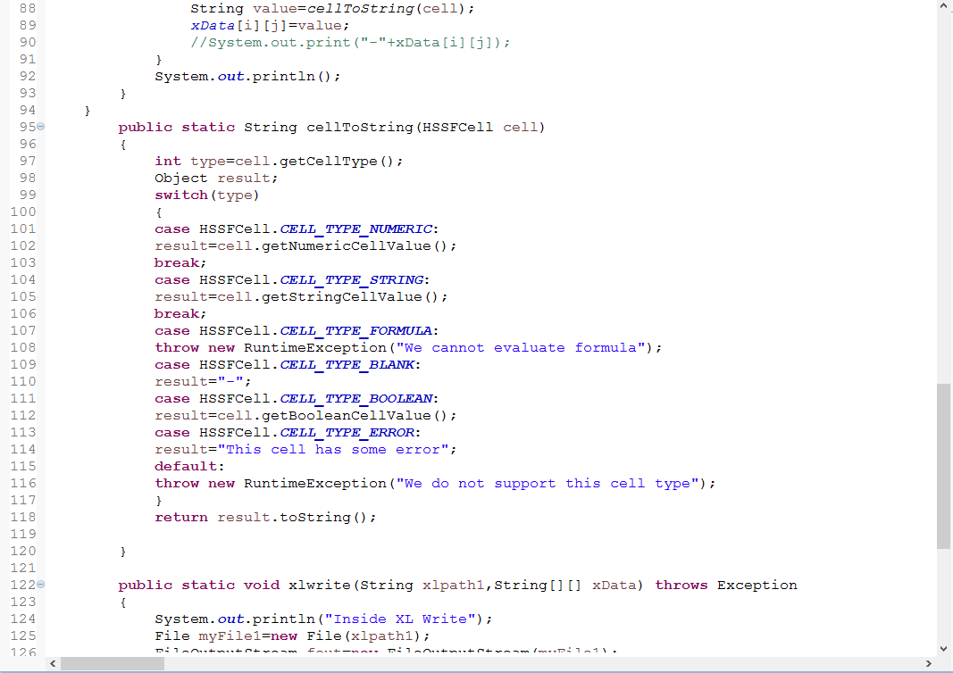
Contd.

Slide 39
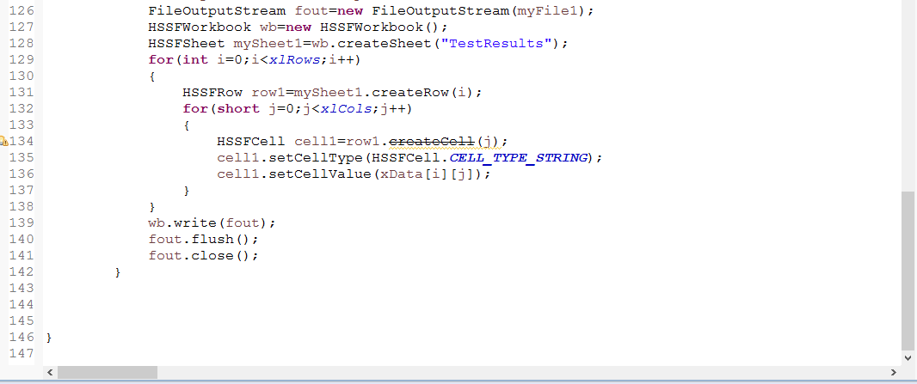
Contd.

Slide 40
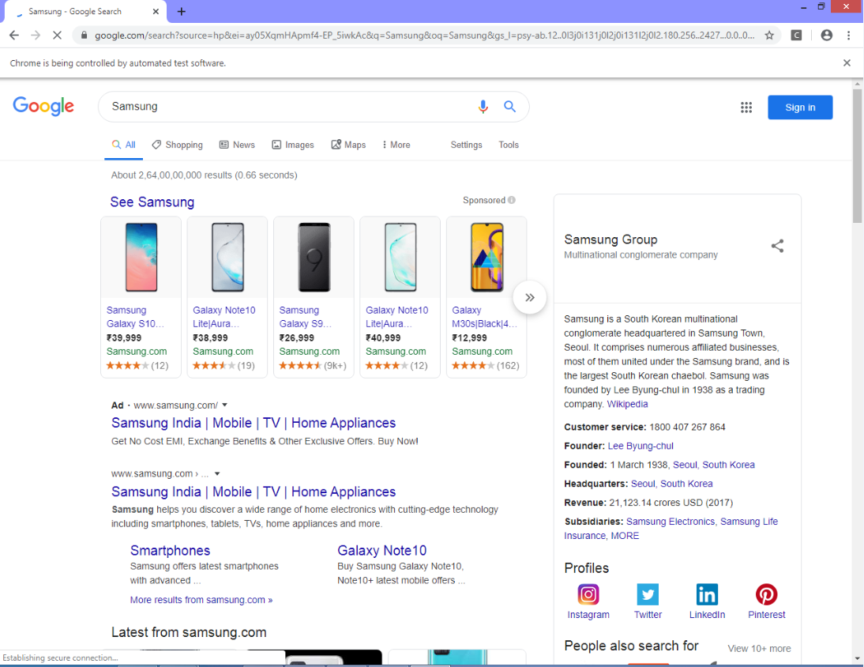
Execution

Slide 41
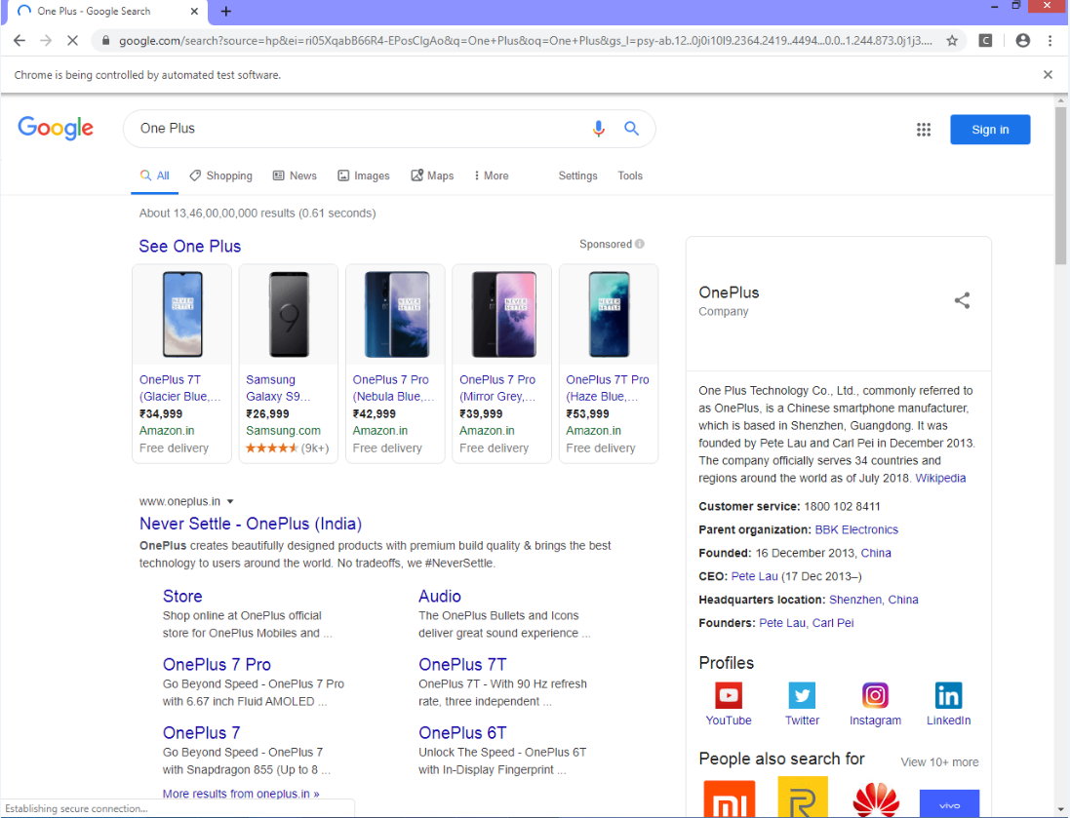
Contd.

Slide 42
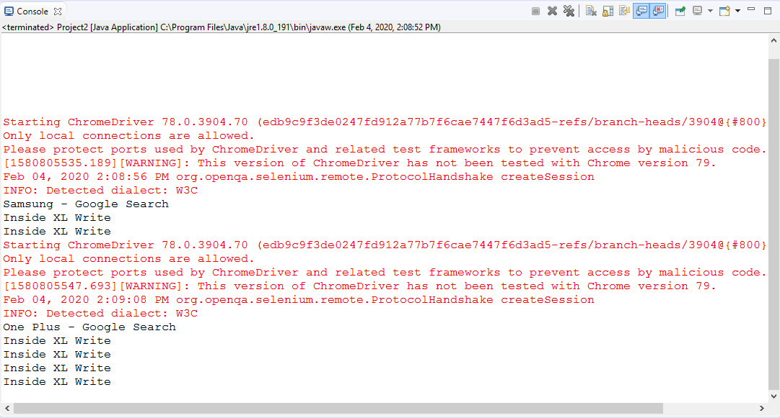
Console Output

Slide 43
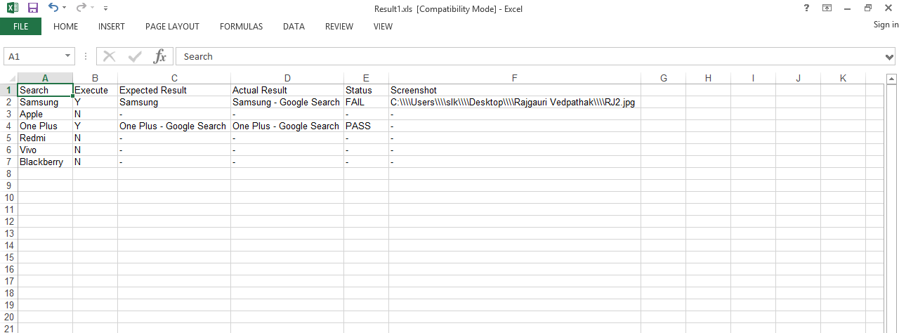
Result File

Slide 44
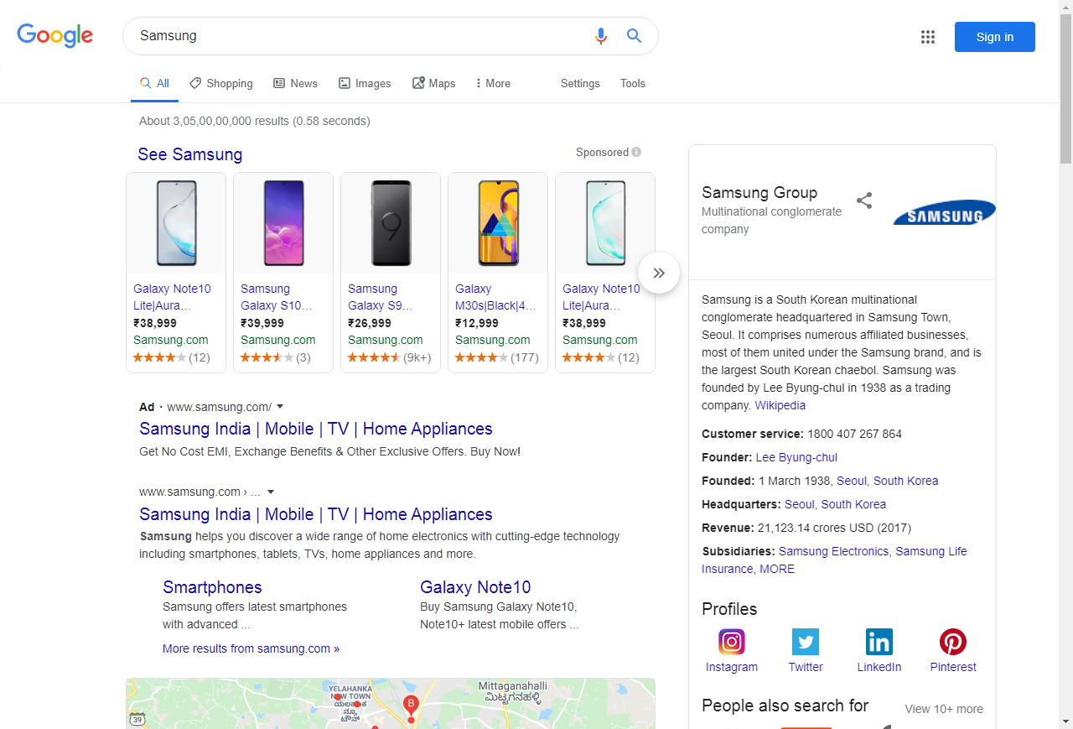
Screenshot Captured for Failed Test Case

Slide 45
References - Github
https://github.com/kamathiiii/projects.git
https://github.com/Pooja8050/selenium.git
https://github.com/syedabrar7860/SLK_PROJ-Selenium-SoapUI-.git
https://github.com/Rajgauri-v/Final_project_sel-soapUI.git
https://github.com/HariniSundar123/SLK_Proj-Sel-SoapUI-.git

Slide 46
Thank You

